Slide 1
Pizza Sales Dashboard
File created on: 3/27/2025 10:44:47 AM

Slide 2
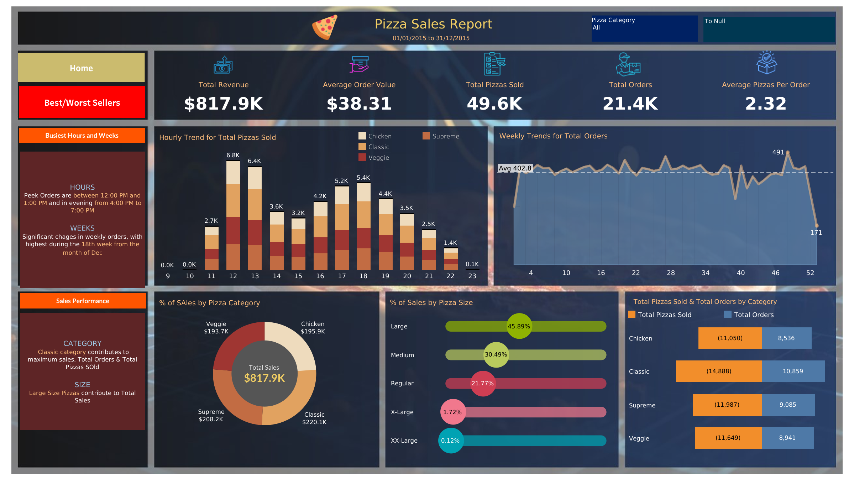

Slide 3
